Slide 1




Kiva loans

Slide 2

Agenda
Introduction
Data Overview
Data Preprocessing
Data Visualization
Machine learning model for prediction
Time series
Visualizations using Power Bi
Conclusion

Slide 3

Introduction:
About Kiva:
Kiva is a non-profit platform that provides microloans to underserved entrepreneurs globally.
Why Analyze Kiva Loans?
Identify top-funded sectors and countries
Understand lender behavior
Predict future funded amounts
Optimize resource allocation and impact
Project Goals:
Analyze funding trends across sectors and time
Examine relationship between lenders and funding
Build a model to predict funded amount

Slide 4
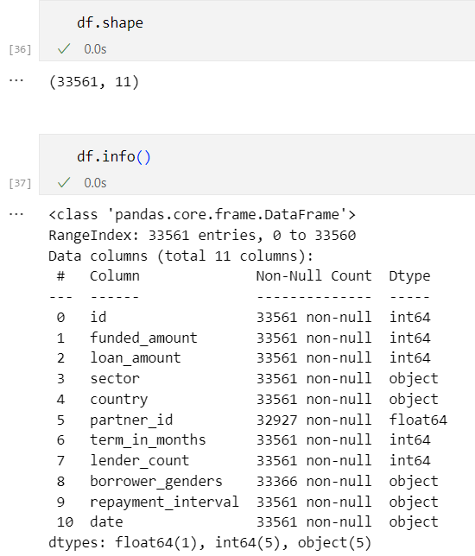
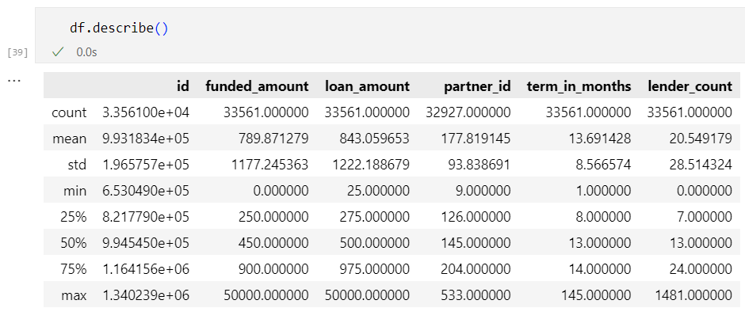
Data Overview:

Slide 5
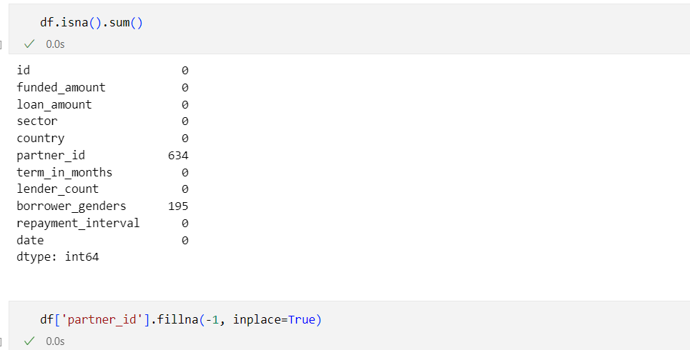
Data Preprocessing:
Handle missing values:
‘Partner_id’

Slide 6
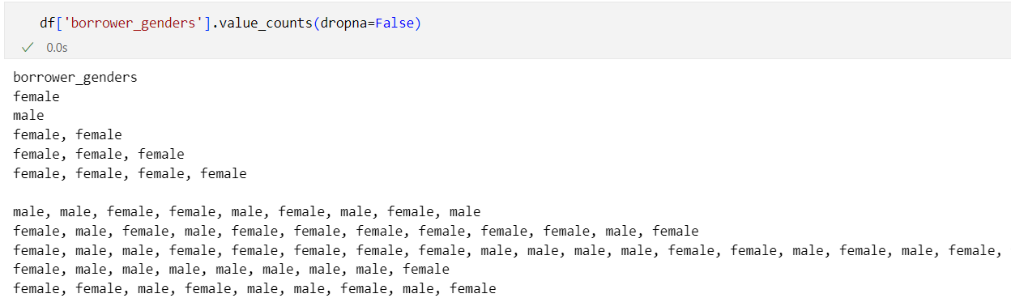
Data Preprocessing:
Handle missing values:
‘borrower_genders’ but we need to normalize this column first!

Slide 7
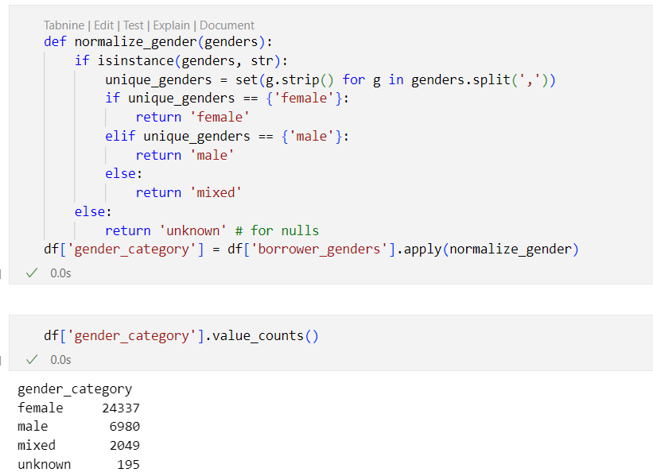
Data Preprocessing:
Normalizing ‘borrower_genders’ & handle missing values

Slide 8
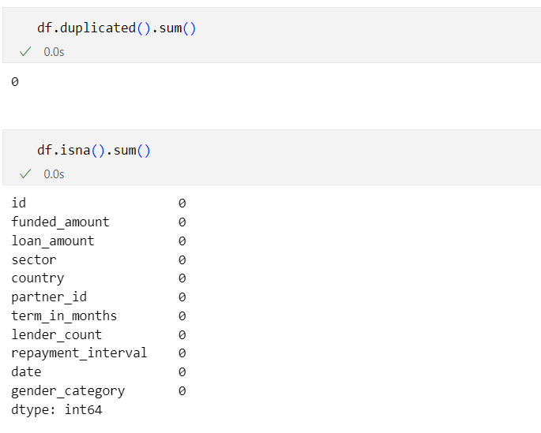
Data Preprocessing:
Check for duplicates or other nulls

Slide 9
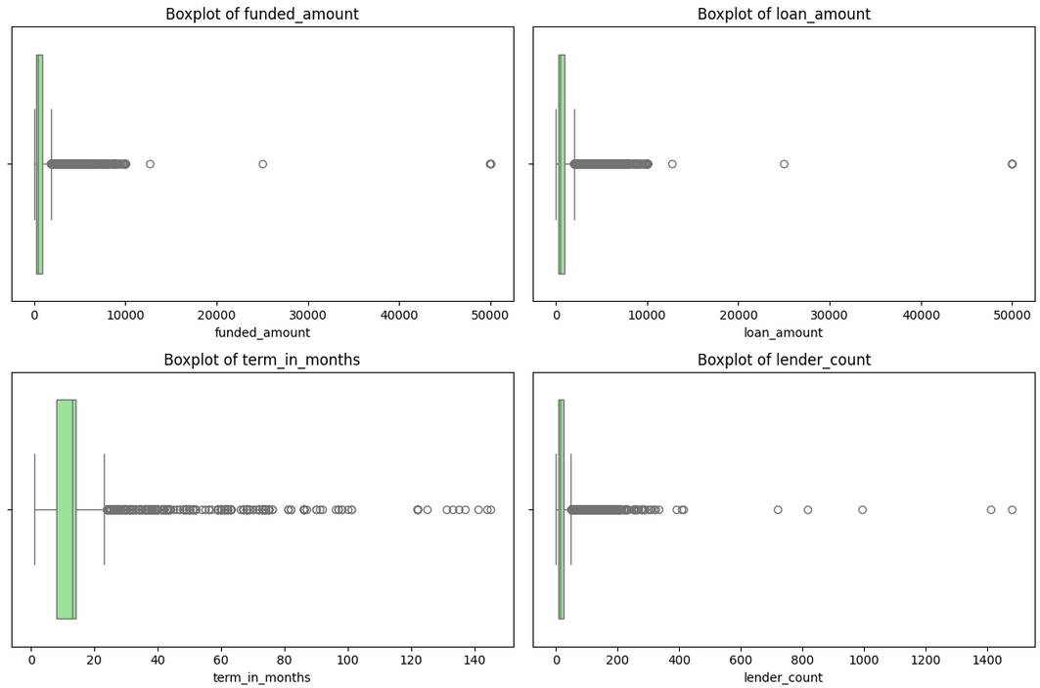
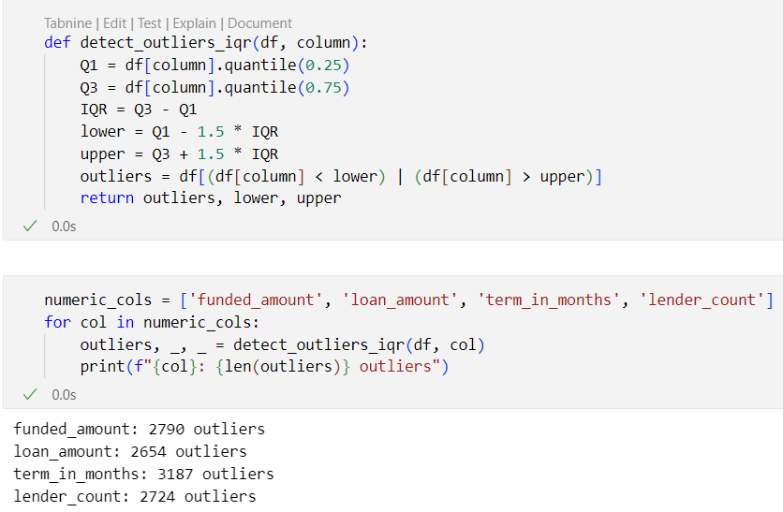
Data Preprocessing:
Detect outliers

Slide 10
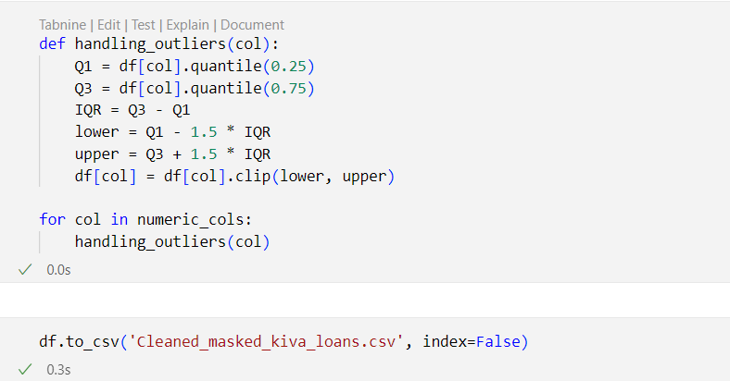
Data Preprocessing:
Handle outliers

Slide 11
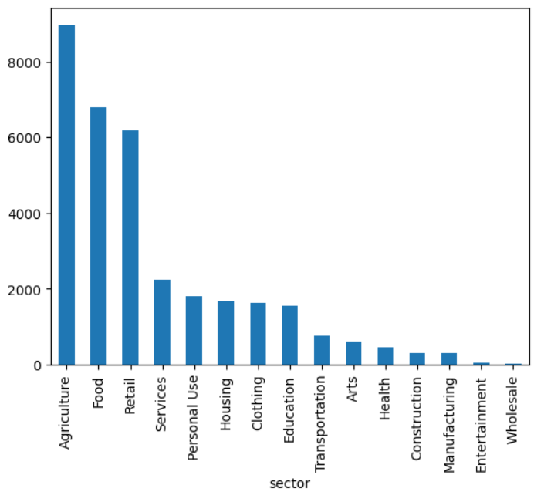
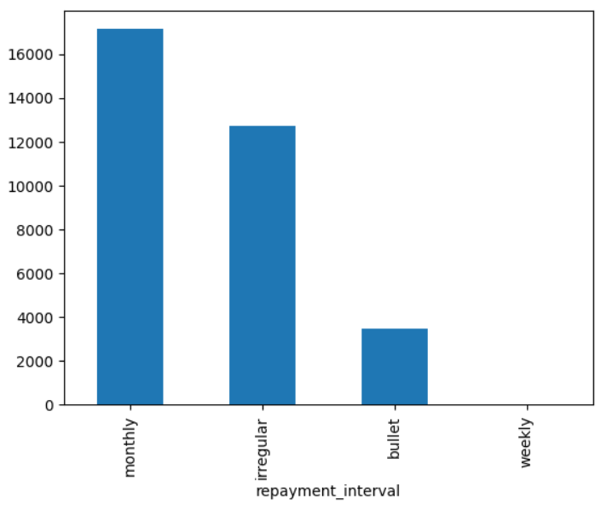
Data Visualization:
1. Categorical Columns:

Slide 12
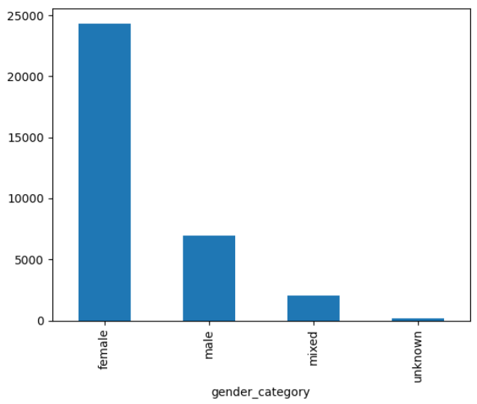
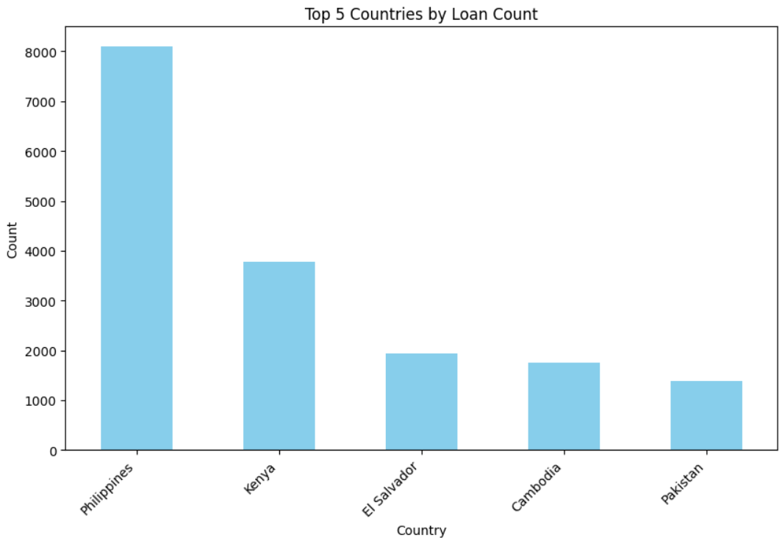
Data Visualization:
1. Categorical Columns:

Slide 13
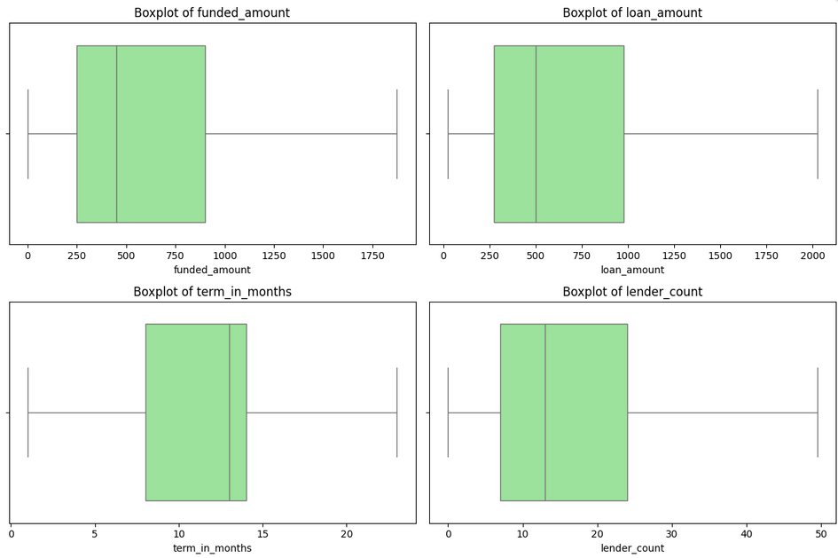
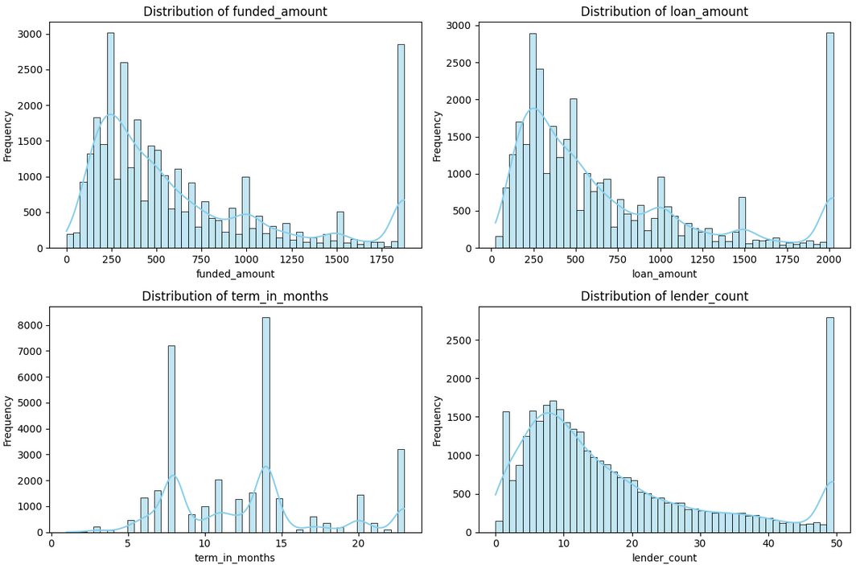
Data Visualization:
2. Numerical Columns:

Slide 14
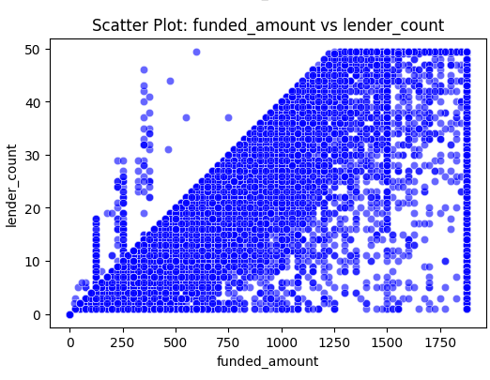
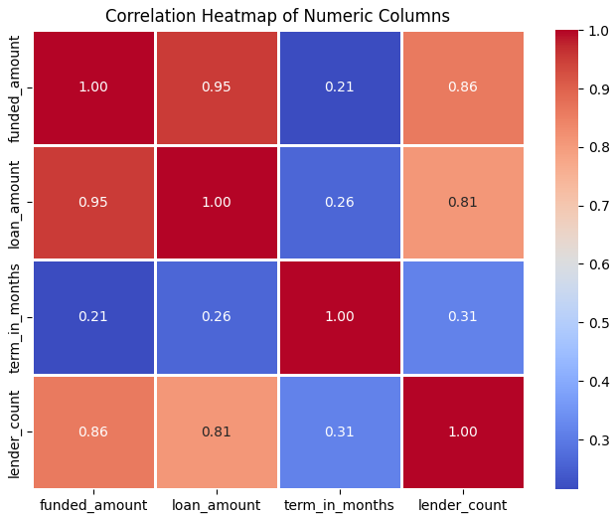
Data Visualization:
2. Numerical Columns:

Slide 15
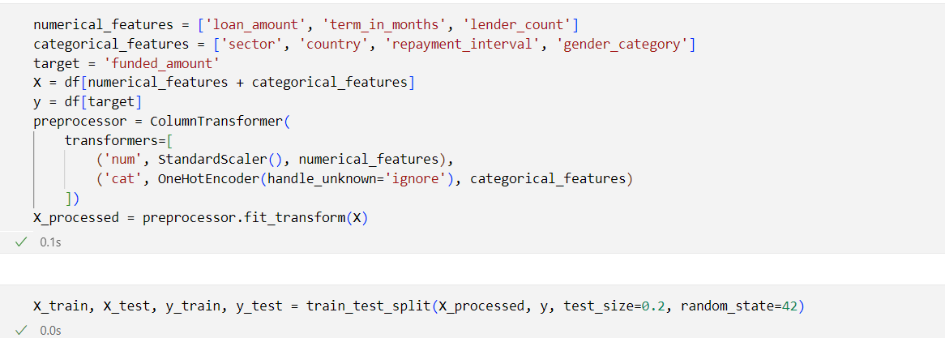
Prediction Models:
Prepare Data for the Model

Slide 16
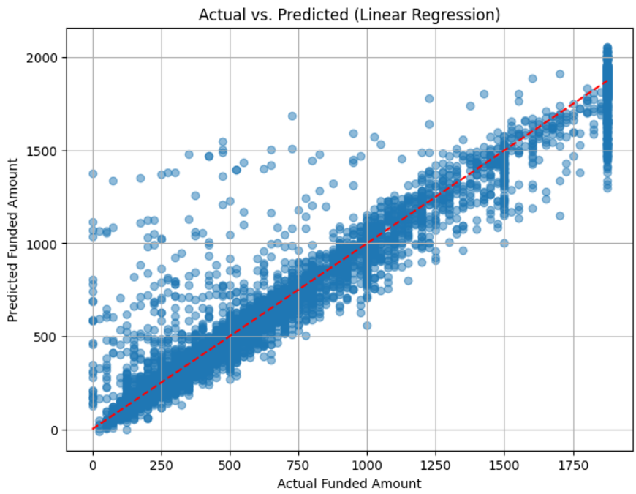
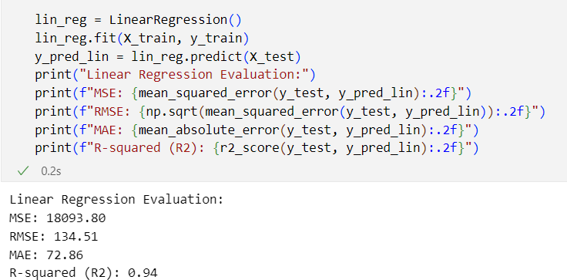
Prediction Models:
1. Linear Regression:

Slide 17
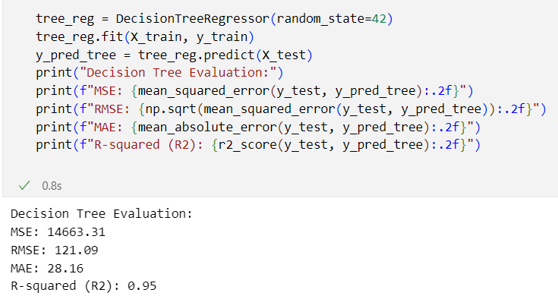
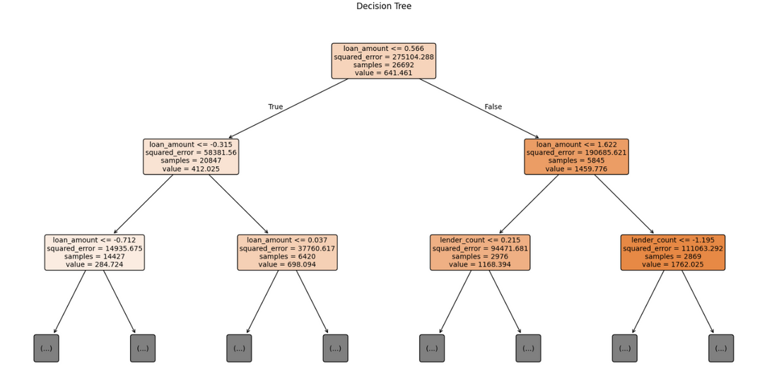
Prediction Models:
2. Decision Tree:

Slide 18
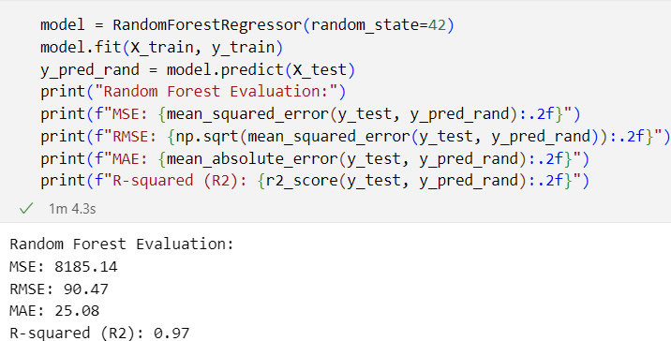
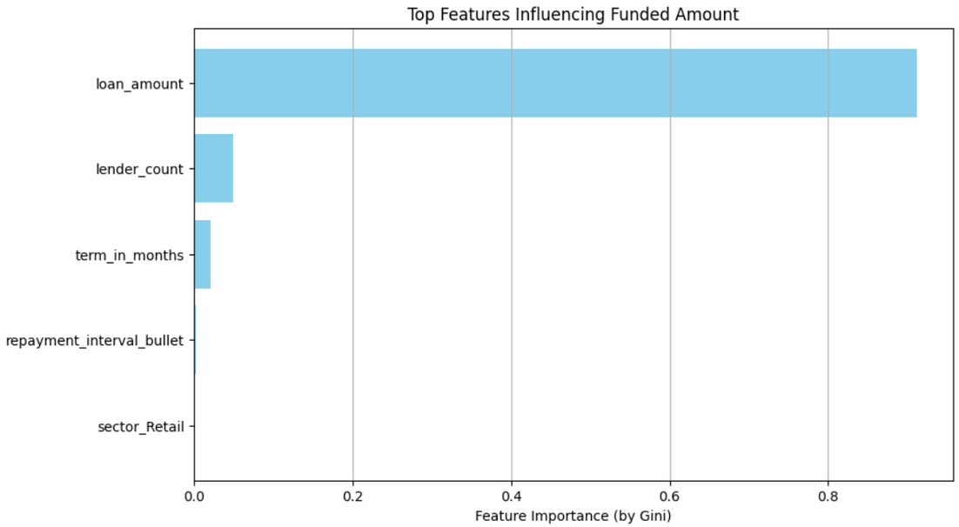
Prediction Models:
3. Random Forest:

Slide 19
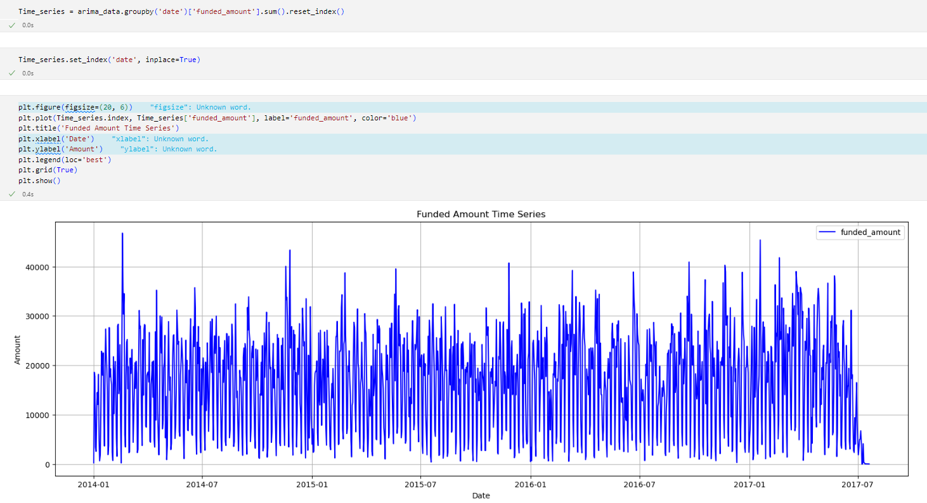
Time series:

Slide 20
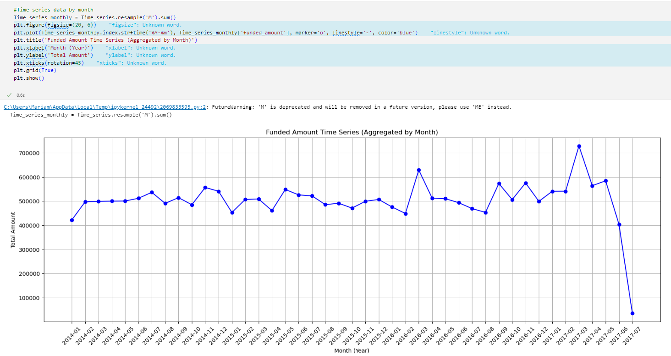
Time series:

Slide 21
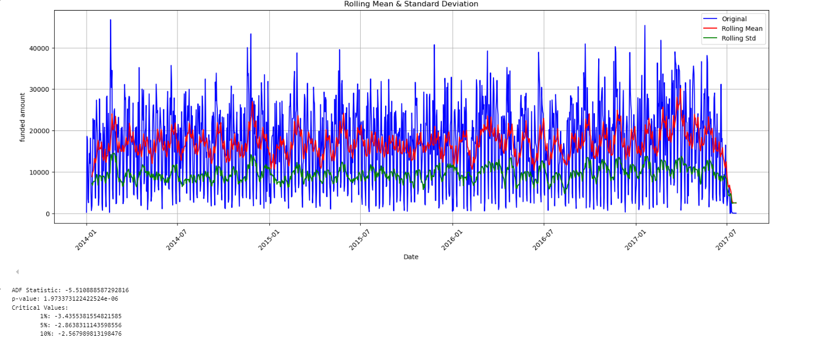
Time series:
since p<0.05, we don’t need to differentiate

Slide 22
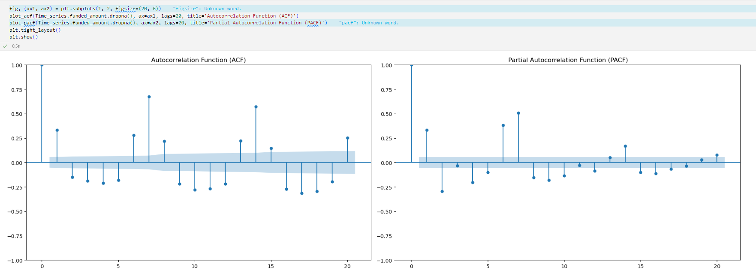
Time series:

Slide 23
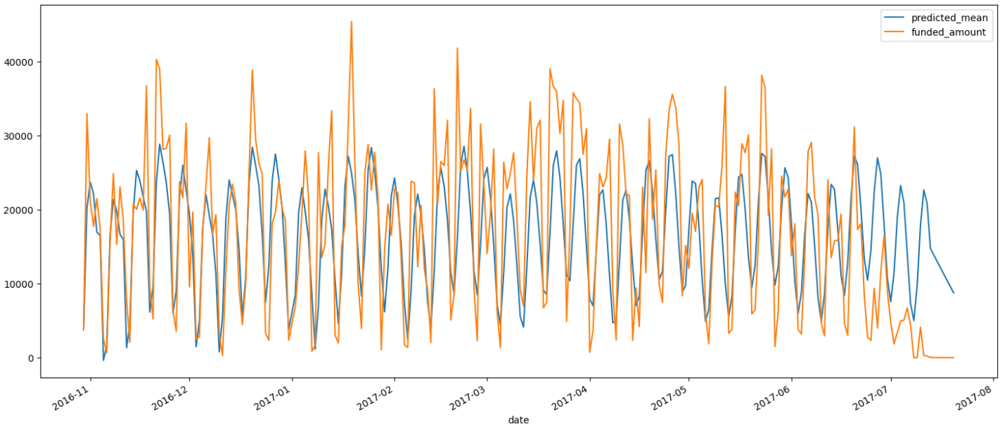
Time series:
R-squared (R2): 0.42

Slide 24
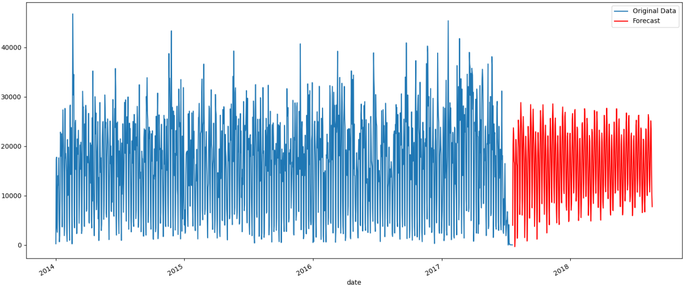
Time series:

Slide 25
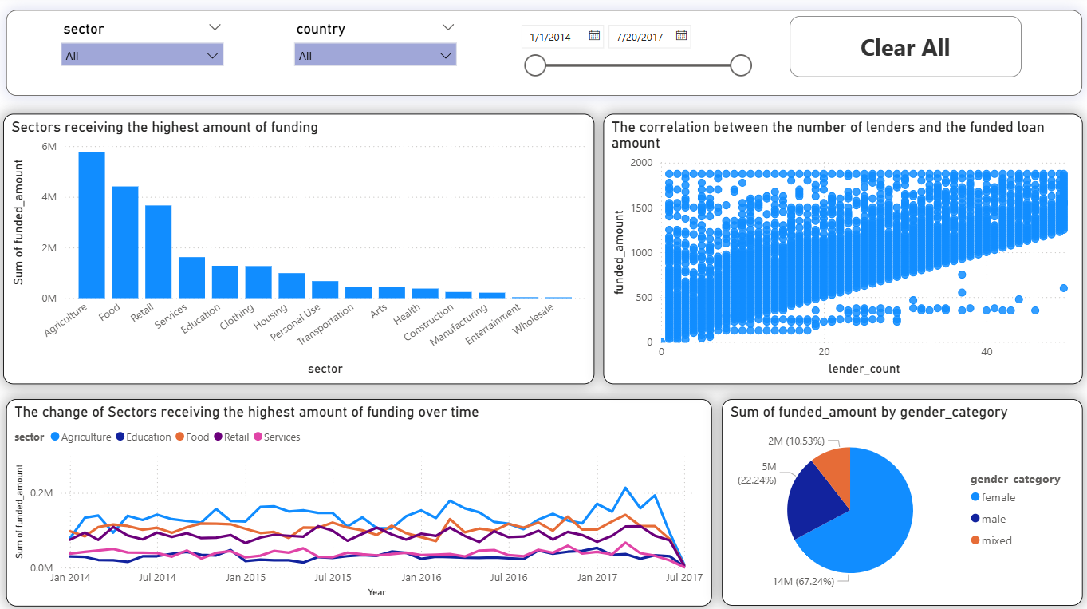
Visualizations using Power Bi

Slide 26
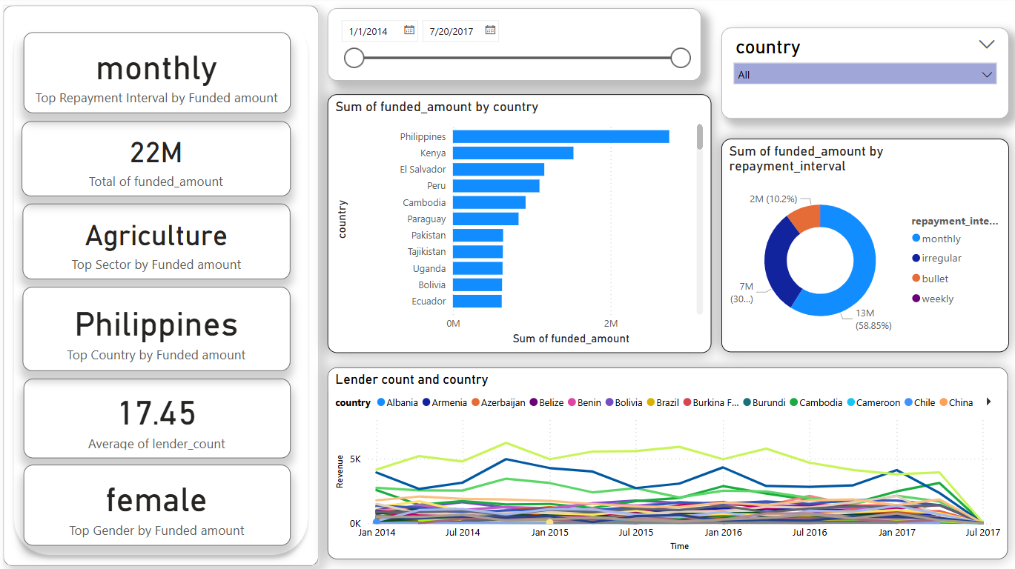
Visualizations using Power Bi

Slide 27
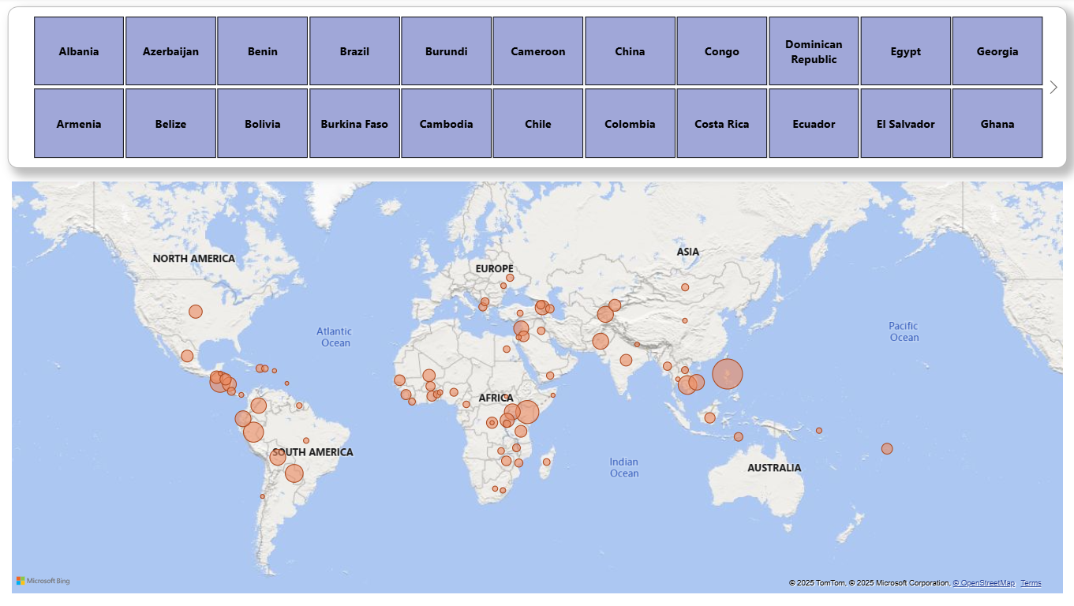
Visualizations using Power Bi

Slide 28


Conclusion
Best Model for predicting future loan amounts based on historical data
01
we can see that Random Forest model was the best one with RMSE= 98.99, MAE: 26.32, R2: 0.97
Sectors with the highest amount of fundings
02
Agriculture with approximately 6M
Food with approximately 4.5M
Retail with approximately 3.5M
Positive correlation of 0.86 between the number of lenders and the funded amount
03
As number of lenders increase, funded loan amount increase.

Slide 29
Thank You!

